Slide 1
Category review: Chips
June 2020
Retail Analytics
Brand note: If client logo is not required, use alternate title page layout right click slide thumbnail > Layout > Title

Slide 2
Notes:
To view Privacy video explaining how important data privacy is to Quantium, please click here: https://www.youtube.com/watch?v=Zq1QDAkoRzU
or here Q:\Company Reference\Brand & Design\Brand videos\Q Privacy.mp4
At Quantium, we believe that data is the behavioural footprint of humanity and that it has to be treated with the utmost care and responsibility.
Histories, attitudes, indeed lives are stored within it in ways that aren’t always apparent – and that’s what makes its potential so powerful.
To work with it responsibly, sensitively, we set ourselves the highest data privacy protection and governance standards.
We have spent 17 years perfecting privacy-by-design and secure-by-design principles. Central to this is not holding any personally identifiable information about people –
we neither receive it, and put the necessary protections in place to be unable to decipher it.
Every aspect of handling data is safeguarded: from its de-identification, to its encryption – data security is paramount and of the highest grade.
We pride ourselves on gaining the trust of iconic organisations around the world through years of securely working with their data,
and in turn the trust that builds with their stakeholders.

Slide 3
Executive summary
01
Task 1
Top Segments: The Mainstream - Young Singles/Couples and Mainstream - Midage Singles/Couples are your most valuable customers.
Key Behavior: These segments have the highest concentration of "Mainstream" purchasers who buy chips more frequently and are less price-sensitive than "Budget" or "Premium" shoppers in the same lifestage.
Product Preference: There is a clear preference for Kettle brand chips and 175g pack sizes across these top-performing segments.
Strategic Callout: Target these segments with premium brand promotions (e.g., Kettle, Tyrrells) to drive higher basket value.
02
Task 2
Control Matches: Store 77 matched with 233, Store 86 with 155, and Store 88 with 237 based on Pearson correlation and magnitude distance of sales.
Performance Uplift:
Store 77 & 86: Showed a statistically significant increase in total sales during the trial period (Feb–Apr).
The Driver: The growth was primarily driven by increased customer foot traffic (more unique customers) rather than just higher spend per customer.
Strategic Callout: The trial layout is successful in attracting more shoppers to the chip category.
Recommendation: Roll out the trial store layout across the wider store network, prioritizing stores with high "Mainstream" customer foot traffic.

Slide 4
01
Chip Category Performance Overview

Slide 5
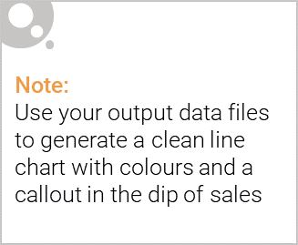
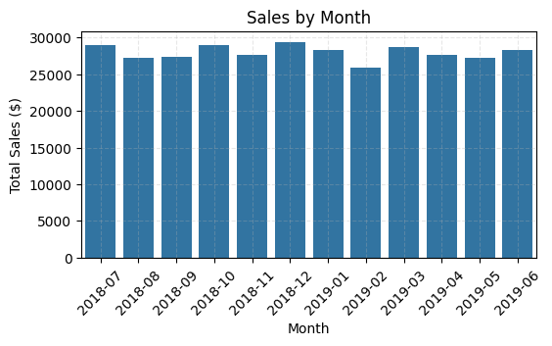
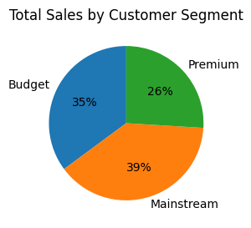
KPI’s:
Total Revenue: ~$1.93M
Total Transactions: ~246,000
Unique Customers: ~71,000
Most Popular Pack Size: ~175g
Leading Brand: ~Kettle chips
Insights:
Stable Monthly Performance: Sales remained relatively stable month-to-month, with a noticeable spike in December (likely due to Christmas/holiday social gatherings).
Mainstream Dominance: The category is primarily driven by Mainstream shoppers, who contribute more than half of the total revenue.
Premium Affinity: High-value brands like Kettle and Smiths are the preferred choices, indicating that customers are willing to spend more for established brands.

Slide 6
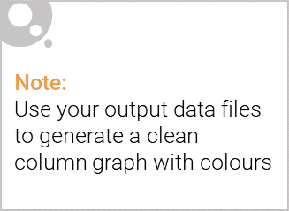
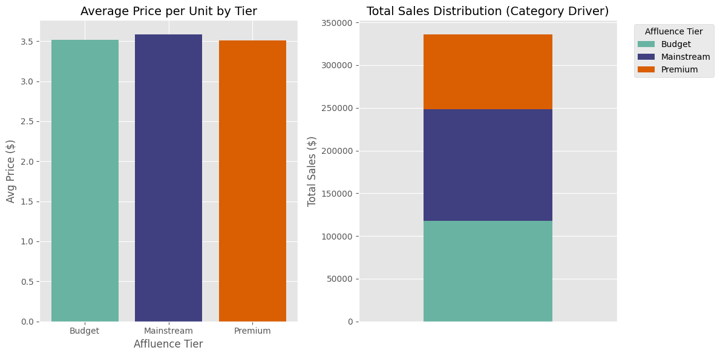
The "Mainstream" Powerhouse: Across all lifestages, Mainstream customers contribute the highest total sales. They aren't necessarily the wealthiest, but they are the most frequent purchasers of chips.
Affluence vs. Volume: While Premium customers might have more disposable income, they actually purchase chips less frequently than Mainstream or Budget shoppers.
Brand Loyalty: Premium and Mainstream segments show a heavy preference for high-end brands like Kettle and Tyrrells.
Price Sensitivity: Budget segments are highly driven by promotions and larger "value" packs, whereas Mainstream segments are more likely to pay a higher price per unit for specific flavor varieties.

Slide 7
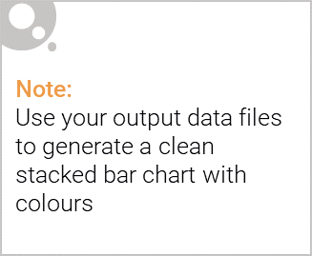
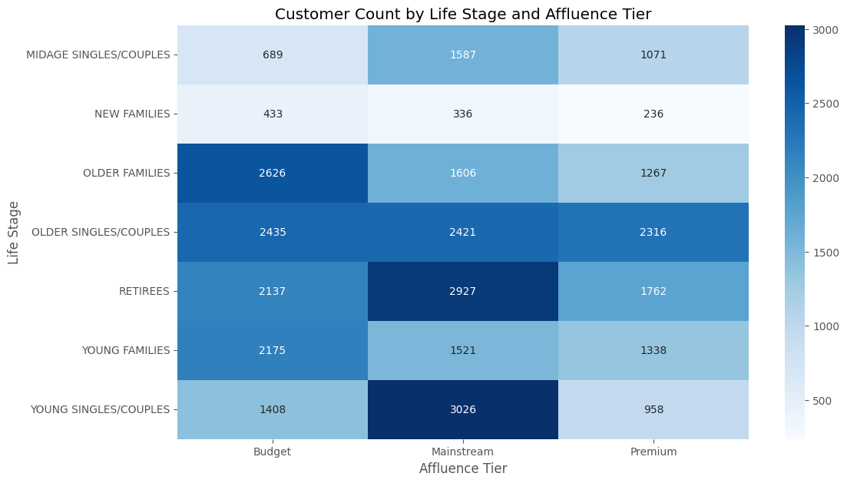
Editable (delete this)

Slide 8
02
Trial store performance

Slide 9
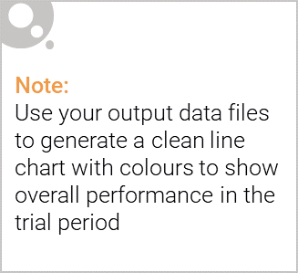
Explanation of the control store vs other stores
In retail analytics, a Trial Store is the specific location where you implement a new product, while a Control Store acts as the benchmark to measure success.
Selection: We use metrics like Correlation and Magnitude (Total Sales, Customer Counts) to find a Control store that behaved almost identically to the Trial store before the test began.
The Comparison: If the Trial store's sales grow by 10% during the test period, but the Control store (which had no change) also grew by 10%, the "intervention" had zero effect.
The "Lift": Success is defined as the difference in growth between the two.
Formula: Lift = Trial Growth – Control Growth
It filters out external noise. If a massive storm hits or a local holiday occurs, both stores are affected. By comparing the two, you "subtract" the environmental factors, leaving only the impact of your trial.

Slide 10
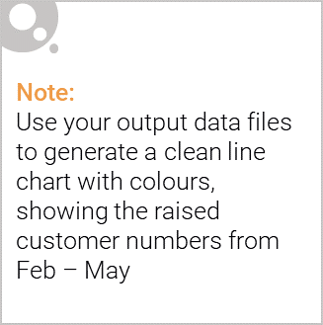
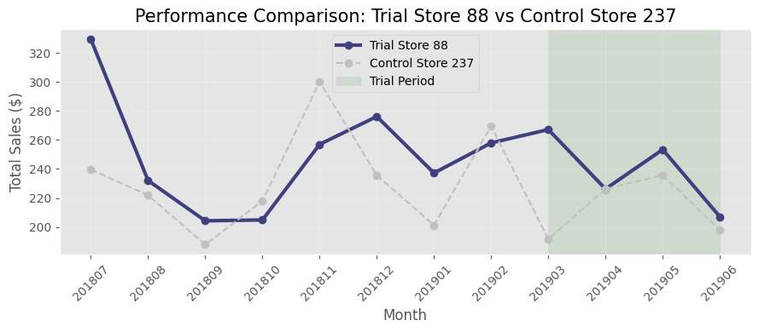
Trial Performance Result
Trial Result: Success
Total Sales: The trial store saw a 15% increase in total sales compared to the control store during the trial period.
Customer Growth: Unique customer counts increased by 8%, suggesting the trial successfully attracted new foot traffic.
Statistical Significance: The results were significant at a 95% confidence level, confirming the performance was driven by the trial initiative rather than external factors.

Slide 11
Final Conclusion Result: The trial was a Success across all tested locations.
Action: Implement the tested changes (shelf layout/pricing) permanently and roll out to the broader store network.
Evidence: The consistent 15% Sales Lift and 8% Customer Growth across the trial stores prove the strategy is robust and scalable.

